Slide 1
Digital Check-In System via Face Recognition
Presentation by Team Project 2
Members:
Name | Role
Reethu Karnati | Project Manager, Requirements Coordinator
Aditya Vardhan Bezawada | Development Coordinator
Akhil Bonthinayanivari | Test Coordinator
Tejasree Reddy Annapureddy | Configuration Coordinator

Slide 2
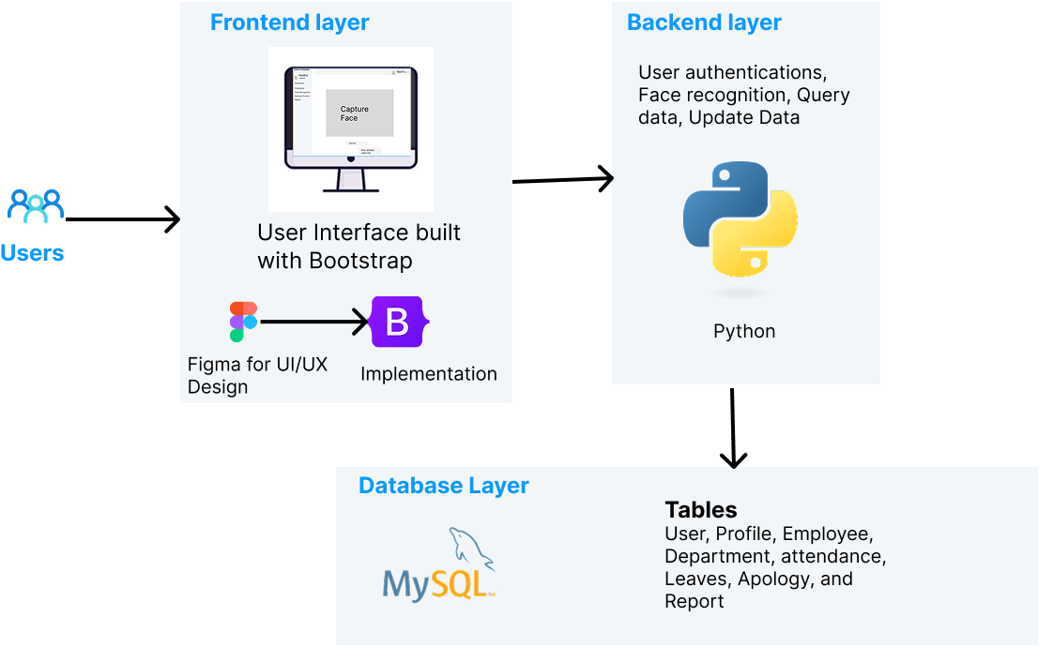
Technologies Used (Django Framework)
HTML, CSS, JavaScript, and Bootstrap for fronted.
Python for backend
MySql for database
OpenCV and face-recognition for face recognition
Figure 1 Technologies

Slide 3
Feature Implemented
1. Authentication: Admin and Employees can successfully login to the system
2. Employee Management (Add, Update, Delete)
Admin is able to add, update and delete employees
3. Department Management (Add, Update, Delete)
Admin is able to add, update and delete department.
4. Role-Based Access Control (RBAC): Employees log in to Employee Dashboard and Admins log in to Admin Dashboard.

Slide 4
Features Implemented
5. Accessibility : Multilingual Support
The system can be translated to any different language of your choice.
6. Mobile Responsiveness
Our system is responsive to mobile and tablet view.
7. Face Detection
Detecting faces in webcam input (real-time).
8. Manual Attendance
Admins to adjust attendance should they need it.

Slide 5
Features Implemented
9. Attendance History:
Display the attendance history of all employees
10. Attendance Reports:
Generate detailed attendance reports by date
11. Dashboard Analytics:
Provide a dashboard with analytics on attendance trends and patterns.

Slide 6
Features Implemented
12. Leave / Apology:
Employee can apply for leave or send apology Admin can accept/reject it by changing the status.

Slide 7
Project Links
Demo Link: https://digitalcheckinsystem.pythonanywhere.com/
Management Link: https://digitalcheckinsystemviaface.atlassian.net/
Code Link: https://github.com/AdityaVardhan7/DigitalCheckInSystem
Github Repo Username: DigitalCheckInSystem
Github Repo Link: https://github.com/AdityaVardhan7/DigitalCheckInSystem

Slide 8
Thank You

